Slide 1
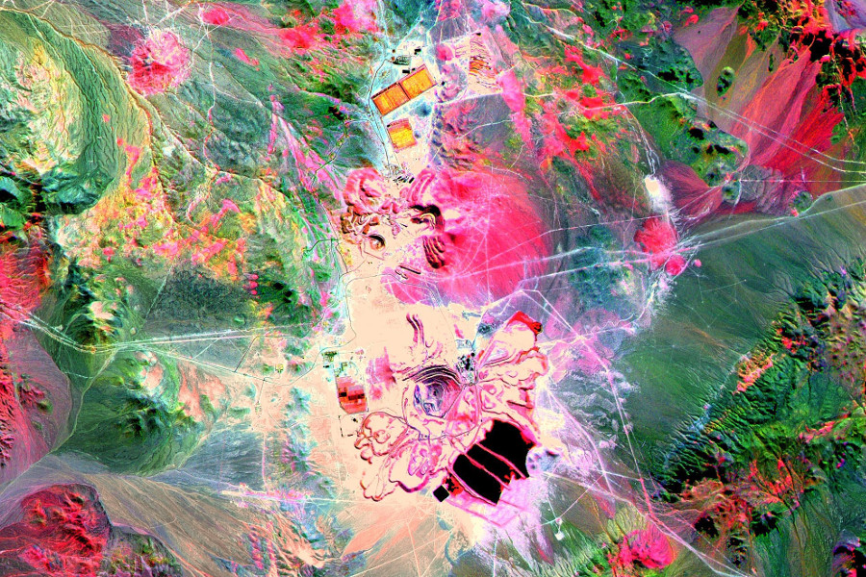
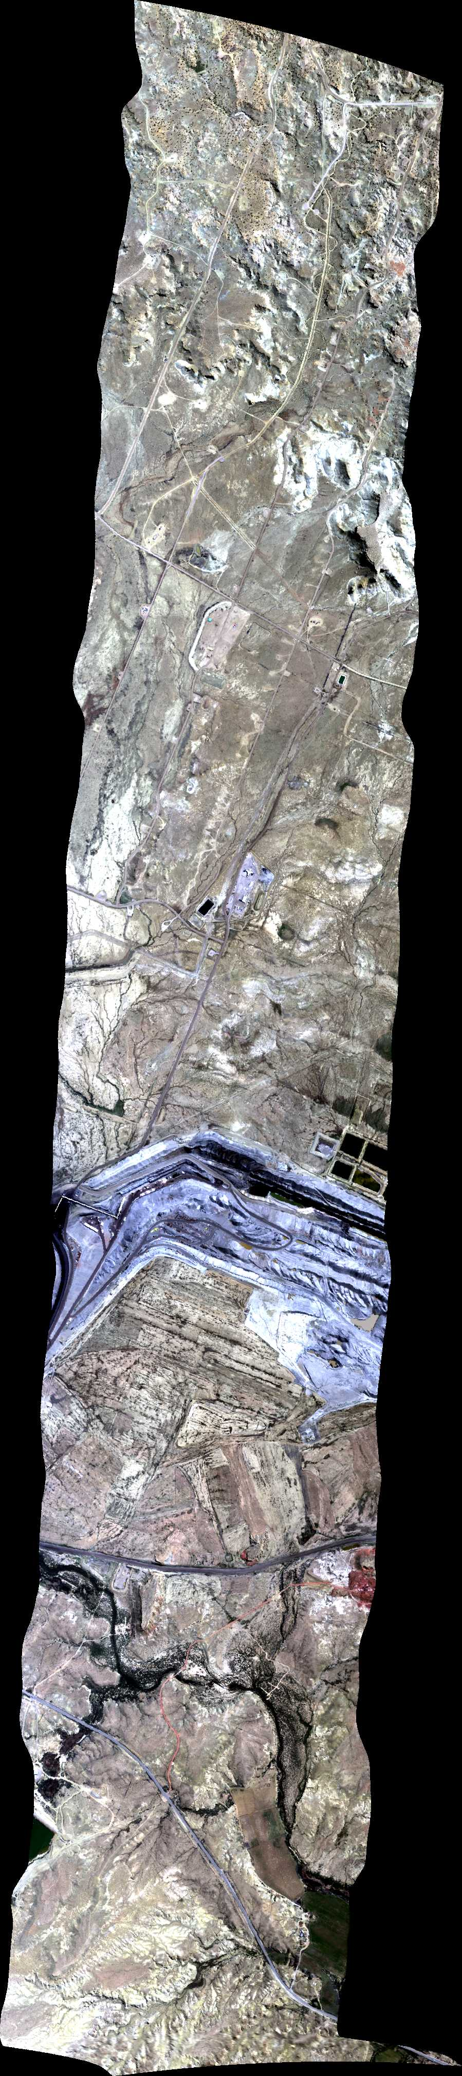
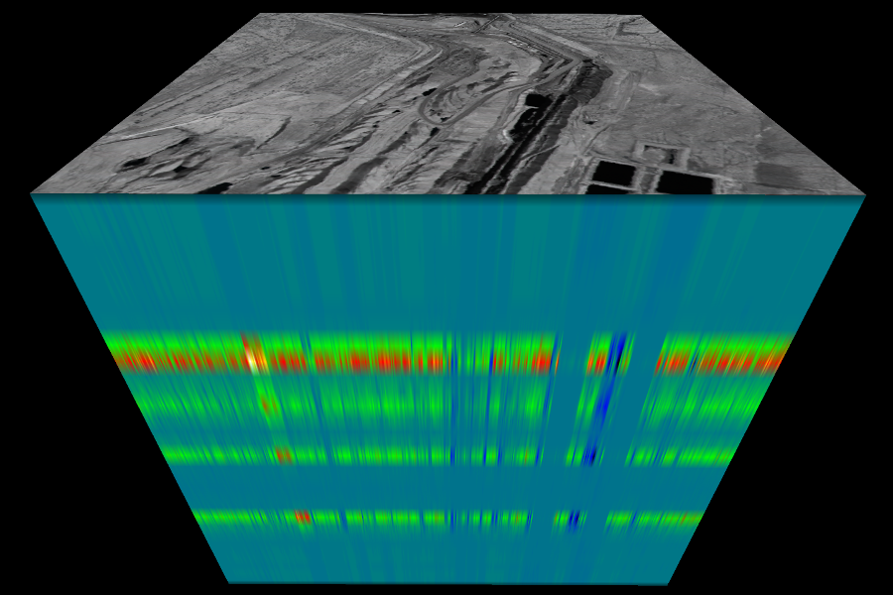
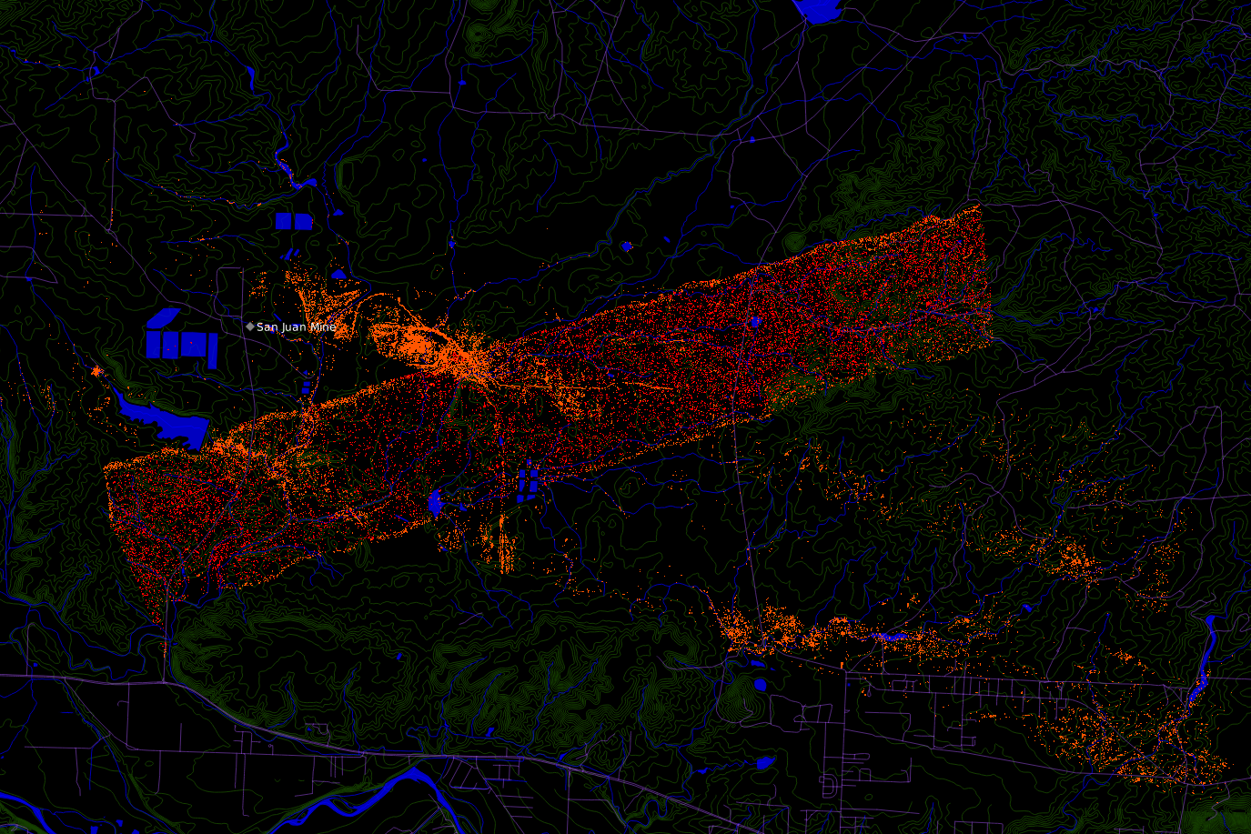


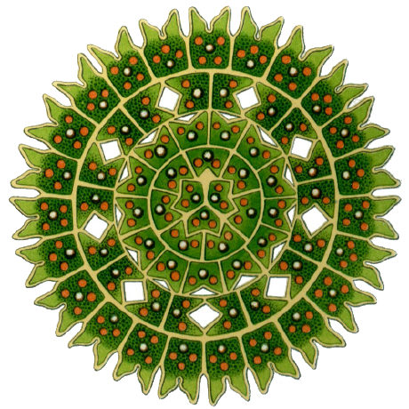


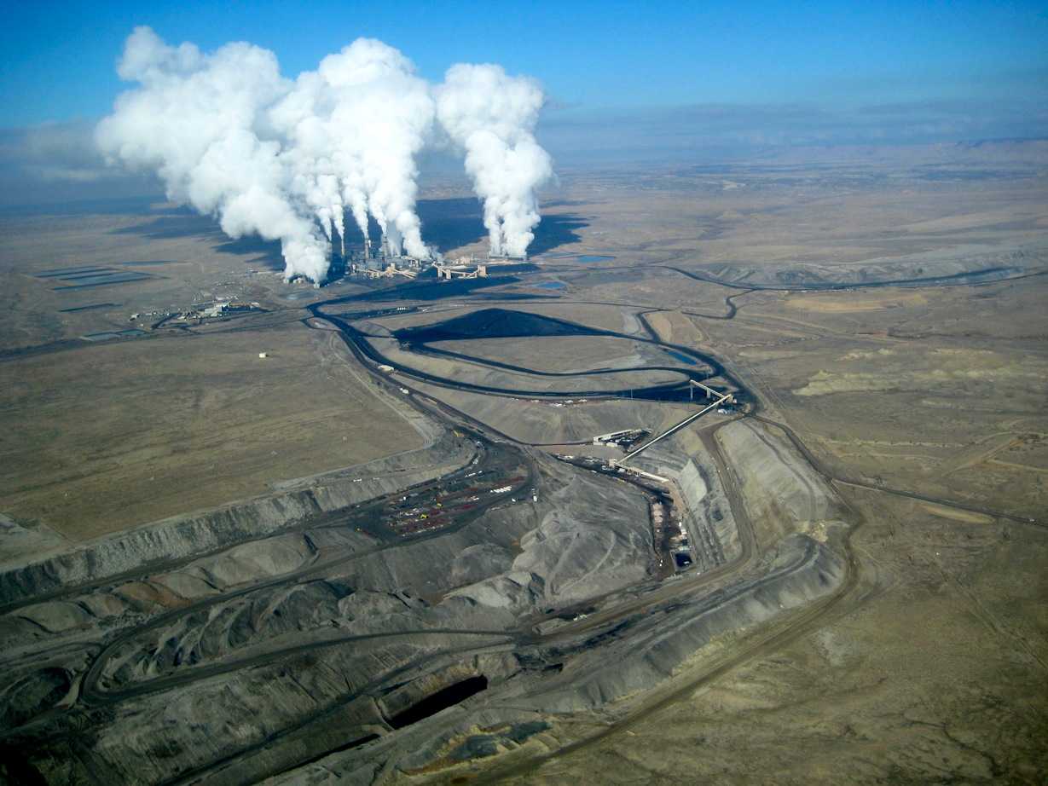
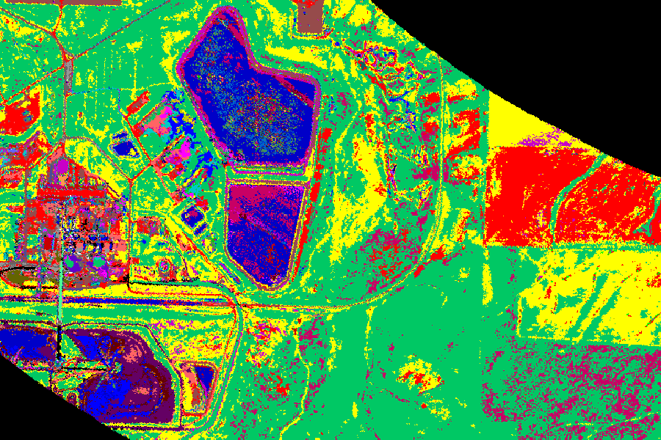
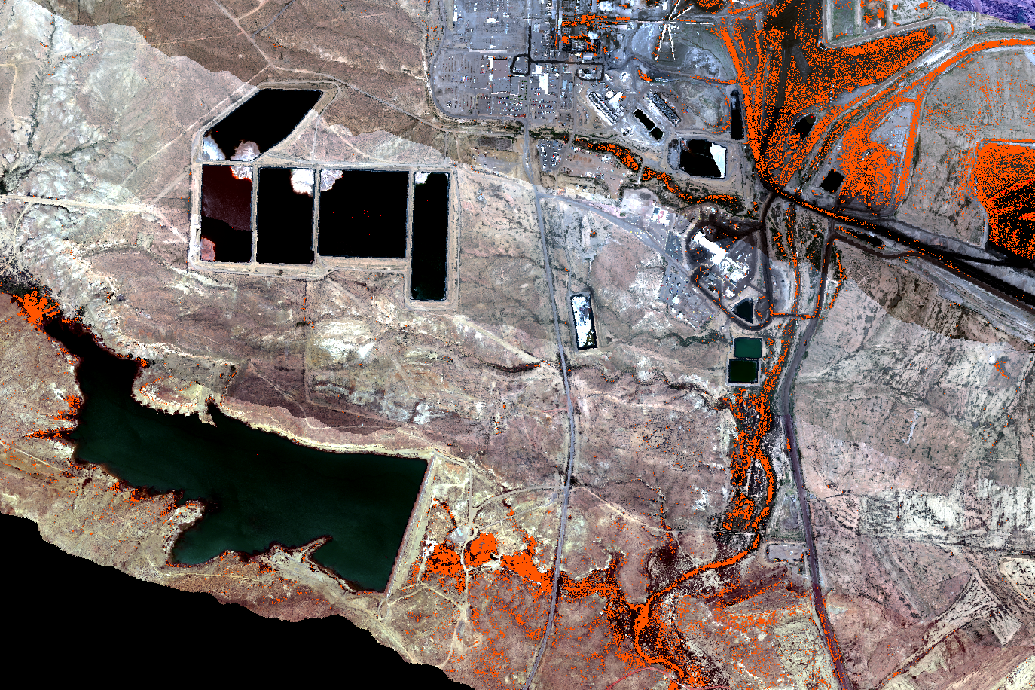

Coal and Open-pit surface mining impacts on American Lands (COAL)
Measuring mining impacts on water resources
COAL is a Python library for processing hyperspectral imagery from the Airborne Visible/InfraRed Imaging Spectrometer (AVIRIS-C & AVIRIS-NG)
Problem
Mining is known to affect the environment, but few software tools exist to quantify its impacts
A large volume of AVIRIS imagery is available
Spectral libraries contain samples of thousands of minerals and other materials
Environmental data is collected by local, state, and national governments as well as non-governmental organizations
Our goal is to contribute tools to combine this data in a coherent way
Solution
Python library implementing a suite of algorithms
Classify minerals and other land surface types
Identify mines and other geographic features
Correlate environmental impacts with mining operations
Release as Free and Open Source Software
Hyperspectral imagery of the Escondida Mine in Chile. Courtesy NASA/JPL-Caltech.
Capstone COAL
Team
Lewis John McGibbney, Ph.D. Data scientist in the Computer Science for Data Intensive Applications Group at JPL. <lewis.mcgibbney@gmail.com>
Kim Whitehall, Ph.D. Tropical climate variability and climate change researcher and educator at JPL.
Taylor Alexander Brown Computer Science major with emphasis in computer systems and math minor. <browtayl@oregonstate.edu>
Heidi Clayton Computer Science major with an applied option in statistics. <claytonh@oregonstate.edu>
Xiaomei Wang Double major in Finance and Computer Science. <wangx2@oregonstate.edu>
Three-dimensional visualization of hyperspectral imagery displaying spectral bands
Map of coal mine, waste classifications, water resources, and surrounding geography.
Mineral Classification
All minerals have unique spectral signatures
Samples of those spectral signatures are contained in spectral libraries e.g. ASTER, USGS and ENVI
Using the raw AVIRIS images with unknown land cover and spectral signatures, classify each pixel with spectral angle mapper classification. Other classification options exist e.g. unsupervised K-Means, supervised Gaussian Maximum Likelihood, Mahalanobis Distance and Multi-Layer Perceptron
Output is a mineral classified file where each pixel is assigned to a particular class in the spectral library
Environmental Correlation
Map identified mines in GIS applications and correlate them with water quality measurements
Determine whether water pollution is linked to mining
Use results to enhance environmental understanding
Temporal Analysis
Implement a Science Data System to batch process past and present imagery
Facilitate research with unique data products
Enable analysis of changes over time
Future Work
Accepted as OSU Senior Capstone 2017-2018 COAL Follow-On focused on improving classification algorithms
Leverage NSF-funded XSEDE Startup HPC Allocation to process entire AVIRIS-C/NG archive
An AVIRIS flightline over the San Juan Coal Mine
in Waterflow, New Mexico
Mining Identification
Use certain classes of minerals as proxies for presence of mining
Output is a mining classified file where each pixel is identified as either corresponding to mining or not
Website
For more information, visit our website:
https://capstone-coal.github.io
The San Juan Coal Mine and Generating Station. Courtesy San Juan Citizens Alliance/EcoFlight.
Mineral-classified image showing land surface types surrounding a coal facility in Craig, Colorado.
Distribution of coal mining waste classifications along streams and water bodies.
Jet Propulsion Laboratory, California Institute of Technology
© 2017. All rights reserved.
Notes:
If tri-fold mounting at SMS – make sure no text or image is in-between the two vertical guide lines; this space will be cut away. To view the vertical guide lines: Select “View” from the main menu, select “Guides” from the pull down menu, and lastly select “Static Guides”.

